Slide 1
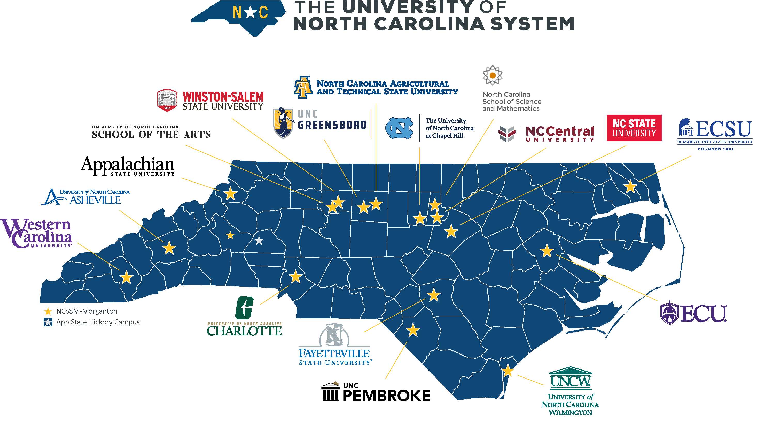

Slide 2

















UNC System Institutions

